Slide 1






OVERVIEW
& CORE CAPABILITIES
TRANSFORM YOUR FUTURE TODAY

Slide 2



VISION OBJECTIVES &
CORE VALUES
Aretum aims to lead in innovation and excellence within technology and professional services, driving global change by empowering clients and employees to break new ground. Through cutting-edge solutions and a people-first approach, we redefine what's possible, setting the standard for operational excellence and transformative growth. Guided by core values of creativity, collaboration, and forward-thinking, we look to continually push boundaries when tackling complex challenges and spark progress across federal industries.​
Innovation at the Core
Customer Focus to the Point of Obsession
Operational Excellence and Accountability
Agility and Adaptability

Slide 3









ARETUM COMPANY
HIGHLIGHTS
Aretum Labs
Products
DHS Contracts
Mid-Tier Agility, Big-Tier Capability
2 Large programs + Largest cyber presences at DHS
Offering broad capabilities with the responsiveness of a smaller, agile firm.
Tailored, Mission-Critical Solutions
DoD Highlight
Operational intimacy driving high-impact results for complex government challenges.
Access to premier GSA, GWAC, and IDIQ vehicles for fast-tracked delivery.
Trusted, High-Caliber Customer Base
FedCiv Highlight
Long-standing relationships with top agencies like Legislative Branch, DHS, DoD, USDA, and DOS.
Library of Congress
Copyright

Slide 4


WHY
ARETUM?
Aretum stands at the intersection of innovation, technology, and strategy, providing end-to-end solutions that empower businesses and government agencies. With our expanded capabilities through the strategic acquisitions of Panum, Miracle Systems, Marton Technologies, and Artemis Consulting, we are uniquely positioned to deliver high-impact solutions tailored to your needs.
Comprehensive Solutions Across Key Competencies ​
Innovative Products from Aretum Labs
Tailored, Client-Centric Approach

Slide 5

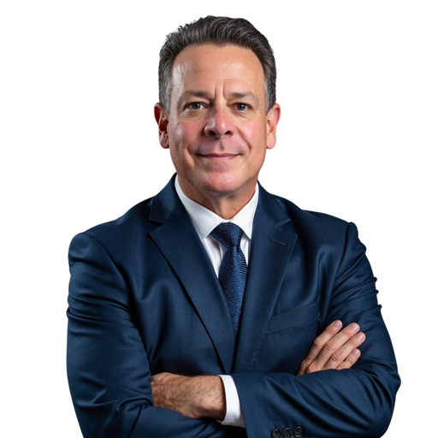

OUR TEAM
MEMBERS
CEO and Operating Partner
EVP - Operations & Growth​
Chief Growth Officer​
Rohit Gupta​
Tiffany Bailey​
Sean DuGuay​
As a visionary leader, Rohit Gupta possesses expertise in scalable systems, AI, and IT operations to drive customer success through digital transformation, supported by a B.E. from the University of Mumbai and an M.S. from the University of Connecticut.​
Tiffany Bailey is a success-driven leader who has achieved 25% revenue growth, built a $1B pipeline, excels in Federal CRM and strategic partnerships, and is a best-selling author with success in Defense and Civilian markets. She is a certified PMP and holds an MBA and MIS. ​
Sean brings nearly 30 years of GovCon experience, including leadership roles at M9 Solutions, Capgemini, ICF, and CGI Federal, and over a decade as a U.S. Marine Corps Special Agent to surge Aretum to higher objectives of growth.​

Slide 6

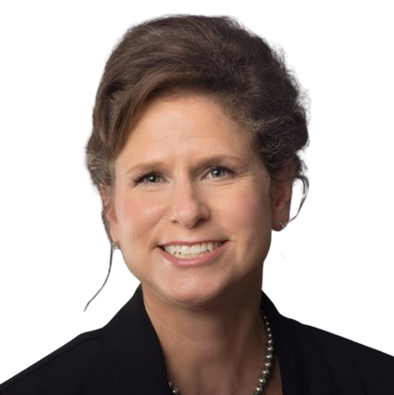
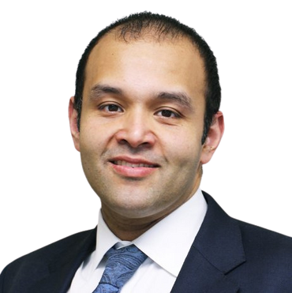
OUR TEAM
MEMBERS
EVP- DOD Sector​
EVP - DHS Sector​
EVP - Federal/Civilian Sector​
Bob Olsen​
Jennifer Totman​
Syed Jaffery​
Bob Olsen, a DoD innovator with nearly 30 years of experience, designed a patented AI solution recognized by Special Operations Command. He specializes in organizational transformation, strategic planning, and program management. Bob holds advanced degrees, multiple certifications, and prestigious military honors, including the Legion of Merit.​
A PMP and Project Management graduate from George Washington University, Jennifer has 25+ years of experience in government contracting. As an expert in DHS operations, she leads ARETUM's strategic vision, overseeing business development, capture management, contract expansion, proposals, and client satisfaction.​
Syed Jaffery, General Manager for the Federal Civilian Sector, focuses on operations, growth strategies, and partnerships. With 15+ years of experience, he excels in business development and federal contracting. He is a certified PMP with engineering degrees from George Mason University.​

Slide 7
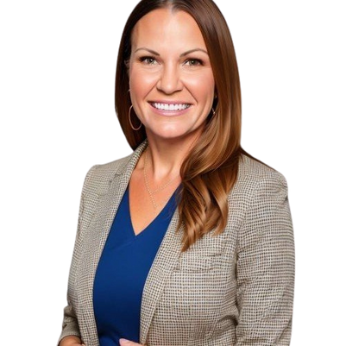
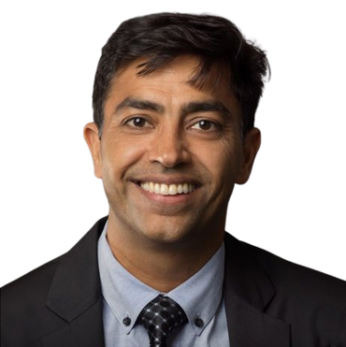

OUR TEAM
MEMBERS
Chief Program Officer​
Chief Accounting Officer​
Chief Human Resources Officer​
Suresh Gulati​
Amy French​
Catherine Gouldin​
Suresh, CPO at Aretum, has 20+ years of experience in program and financial management. At Miracle Systems since 2007, now part of ARETUM, he secured major contracts like GSA OASIS and CIO-SP4 and supports a diverse Federal client base. A PMP, he holds advanced degrees in finance and international relations.​
Amy, Chief Accounting Officer at Aretum, specializes in technical accounting, financial analysis, and compliance with accounting standards. Since joining in 2023, she has implemented new ERP and payroll systems while enhancing controls and ASC 606 adherence. A CPA with degrees from the University of Illinois, Amy is dedicated to efficiency, data-driven insights, and continuous improvement.​
Catherine, Chief Human Resources Officer at Aretum, specializes in compliance, benefits, employee relations, and policy development. With 20+ years supporting government contractors and nearly 30 years in HR, she has worked with employers of all sizes. Catherine holds a Professional Human Resources certification and a BSW from George Mason University.​

Slide 8


MARKETS
AND CUSTOMERS
Department of Defense (DoD)
United States Army (USA)
United States Air Force (USAF)
National Guard Bureau (NGB)
United States Navy (USN)
DEFENSE
United States Department of Homeland Security (DHS)
Transportation Security Administration (TSA)
United States Coast Guard (USCG)
Federal Emergency Management Agency (FEMA)
US Customs and Border Protection (CBP)
US Immigration and Customs Enforcement (ICE)
Federal Law Enforcement Training Centers (FLETC)
Cybersecurity and Infrastructure and Security Agency (CISA)
HOMELAND SECURITY
Library of Congress (LOC)
United States Department of State (DOS)
United States Department of Labor (DOL)
United States Department of Agriculture (USDA)
United States Securities and Exchange Commission (SEC)
United States of America Department of Transportation (DOT)
United States Agency for Internation Development (USAID)
FEDERAL & CIVILIAN

Slide 9




OUR CORE
CAPABILITIES
At Aretum, we specialize in four key areas that drive business and organizational success. These competencies allow us to address the most pressing challenges faced by today’s enterprises and government agencies:
Digital Transformation
Data Intelligence
Cybersecurity
Mission Support
User & Customer Experience
Agile Development
Application Modernization Cloud Enablement
Data & Predictive Analytics
Data Science
Artificial Intelligence & Machine Learning
Natural Language Processing & Deep Learning
Implementation & Integration
Penetration Testing
Authorization and Accreditation
Continuous Monitoring & Remediation
Project Portfolio Management (PPM)/PMO Support
Financial Management Support
Logistics Support
Consulting Services
Human Capital & Resource Management
Exercise & Training Support

Slide 10







DIGITAL TRANSFORMATION
INNOVATIVE DIGITAL SOLUTIONS
FOR THE MODERN GOVERNMENT LANDSCAPE
Who We Are
Aretum drives digital transformation for federal agencies by modernizing IT infrastructure, enhancing user experiences, and boosting operational efficiency. Through agile methodologies and human-centered design, Aretum supports federal clients in achieving mission-critical goals in a shifting digital landscape.
Customer Experience (CX):
Enhance user engagement by combining UX/UI design, to create intuitive, responsive digital experiences.
Cloud Services:
Secure, cost-effective, and scalable cloud services, including architecture, migration, and management.
Agile Development:
Scalable Agile processes that adapt to user needs.

Slide 11









Empowering
Innovation Through Secure, Scalable Solutions
Agile Development
Cloud Services
Aretum offers robust security, scalable solutions, seamless integration, and a focus on continuous improvement to ensure sustainable, compliant, and adaptable results for federal agencies.
Application Modernization
Mobile Development
Cloud Native Development
Open-Source Technologies
DevSecOps & CI/CD Pipelines
Low Code/No Code
Cloud Migration & Development
Cloud Architecture & Engineering
SaaS/LaaS Implementation
Gov-shared Cloud Services
FinOps
Cloud AI/ML Services
Key Components
Customer Experience (CX)
IT Infrastructure & Operations
Security & Compliance
Holistic Integration
UI/UX Design
CX Strategy Development
User Testing & Feedback Analysis
Information Architecture (IA)
Accessibility
IT Modernization
Data Center Implementation
Web Service & Microservices
Network/Database Administration
Enterprise Monitoring
Process Automation
Scalability & Flexibility
Continuous Improvement
EXPLORE OUR SERVICES
www.aretum.com

Slide 12




DATA INTELLIGENCE
WHERE DATA MEETS INNOVATION
FOR SMARTER OUTCOMES
Who We Are
At Aretum, we empower organizations with data intelligence solutions that drive operational efficiency and strategic decision-making. Through cutting-edge analytics, machine learning, and AI-driven solutions, we help agencies leverage data as a key asset to achieve mission-critical objectives.
Advanced Visualizations: Design intuitive, real-time dashboards.
AI & ML Expertise:
Leverage AI an ML for optimization.
Comprehensive Data Services: Transform data with governance and analytics.

Slide 13




Transform Data Into Actionable Insights
Data & Predictive Analytics
Data Science & Advanced Modeling
Aretum provides a comprehensive range of data services, blending strategic insight with technical knowledge to convert raw data into valuable, actionable insights.
Data Strategy
Predictive Modeling
Data Visualization
Self-Service BI
Research & Statistical Analysis
Statistical & Mathematical Modeling
Exploratory Data Analysis (EDA)
Simulation & Optimization Techniques
Risk Modeling & Decision Science
Key Components
Artificial Intelligence (AI) & Machine Learning (ML)
Natural Language Processing (NLP) & Understanding (NLU)
Strategy & Governance
AI-Powered Automation
Conversational AI Solutions
Generative AI Applications
AI-Driven Automation & Process Automation
AI-Based Anomaly Detection & Fraud Prevention
Text mining & Seniment Analysis
Speech-To-Text & Text-To-Speech Solutions
Large Language Models (LLMs)
Machine Translation & Multilingual Support
Chatbot & Virtual Assistant Development
Risk Modeling
Real-Time Dashboards
EXPLORE OUR SERVICES
www.aretum.com

Slide 14




CYBERSECURITY
SECURING YOUR MISSION
PROTECTING YOUR DATA
Who We Are
Aretum delivers robust, tailored cybersecurity solutions to protect federal and government agencies' critical data and IT infrastructure. From cloud security to compliance, we offer end-to-end protection against evolving cyber threats.
Real-Time Protection:
24/7 monitoring and fast threat remediation.
Expertise in Compliance: Proven track record with DoD and civilian agency standards
Tailored Cybersecurity: Custom solutions for your unique needs.

Slide 15

Guarding Your Data, Defending Your Mission
Cloud Security & Zero Trust Architecture (ZTA)
Continuous Monitoring, Response & Remediation
Aretum provides 24/7 monitoring and end-to-end security services to proactively protect your systems across diverse environments.
Cloud Security & Monitoring
Zero Trust Architecture Implementation
Identity & Access Management (IAM) Integration
Security Policy & Procedure Development
Security Incident Response & Forensic Analysis
Threat Hunting & Advanced Persistent Threat (APT) Detection
Security Posture Assessments & Audits
Endpoint Detection & Response
Key Components
Authorization & Accreditation (A&A)
Penetration Testing
Tailored Cyber Defense
Compliance-Centric Security
NIST Risk Management Framework (RMF) Implementation
FISMA, FedRAMP, and NIST 800-53 Compliance Audits
System/Application Security Plans (SSP)
Plan of Action & Milestones (POA&M)
Authority to Operate (ATO) Process Facilitation
External & Internal Network
Vulnerability Assessment & Exploitation
Risk Evaluation & Threat Modeling
Remediation & Patch Management Strategies
End-to-End
24/7 Monitoring
END-TO-END PROTECTION
www.aretum.com

Slide 16
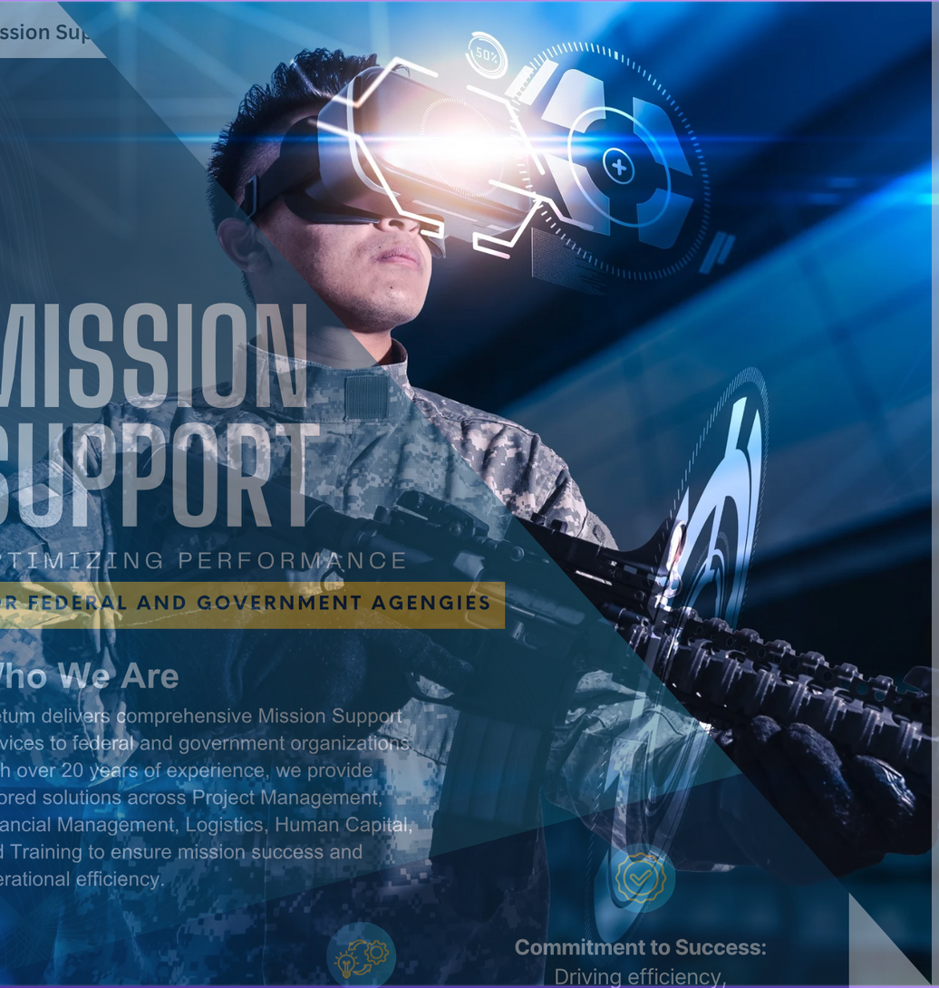


MISSION Support
OPTIMIZING PERFORMANCE
FOR FEDERAL AND GOVERNMENT AGENGIES
Who We Are
Aretum delivers comprehensive Mission Support services to federal and government organizations. With over 20 years of experience, we provide tailored solutions across Project Management, Financial Management, Logistics, Human Capital, and Training to ensure mission success and operational efficiency.
Commitment to Success: Driving efficiency, innovation, and continuous improvement
Tailored Approach: Customized services to meet unique client needs
Comprehensive Solutions: End-to-end mission support across multiple sectors

Slide 17
Your Partner in
Mission Support and Operational Excellence
Project Portfolio Management (PPM) & PMO Support
Logistics Support
Aretum provides 24/7 monitoring and end-to-end security services to proactively protect your systems across diverse environments.
Cloud Security & Monitoring
Zero Trust Architecture Implementation
Identity & Access Management (IAM) Integration
Security Policy & Procedure Development
Security Incident Response & Forensic Analysis
Threat Hunting & Advanced Persistent Threat (APT) Detection
Security Posture Assessments & Audits
Endpoint Detection & Response
Key Components
Financial Management Support
Consulting Services
Tailored Cyber Defense
Compliance-Centric Security
NIST Risk Management Framework (RMF) Implementation
FISMA, FedRAMP, and NIST 800-53 Compliance Audits
System/Application Security Plans (SSP)
Plan of Action & Milestones (POA&M)
Authority to Operate (ATO) Process Facilitation
External & Internal Network
Vulnerability Assessment & Exploitation
Risk Evaluation & Threat Modeling
Remediation & Patch Management Strategies
End-to-End
24/7 Monitoring
END-TO-END PROTECTION
www.aretum.com

Slide 18



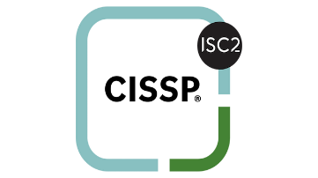

CERTIFICATIONS AND
TECHNICAL PARTNERSHIPS
Certifications
Certified Professionals

Slide 19
ARETUM LABS
Internal Aretum agile software development group researching and develops prototypes using emerging technologies​.
Emerging technologies include but are not limited to:​
Product development and hosting utilizing Amazon Web Services and Google Cloud Platform​
Future research and prototypes: AI trustworthiness scoring tool, Blockchain Git, Blockchain Explorer+ (DOD), RFP analyzer (agency contracts support), proposal submission tool (for contractors), trademark fraud detection (US PTO), PPP loan fraud detection (SBA), population estimator (Census Bureau), grant application scoring (NIH)
Artificial Intelligence (AI) ​
Machine Learning (ML)​
Natural Language Processing (NLP)
and Semantic Search​
Robotic Process Automation (RPA)​

Slide 20



ARETUM LABS
FEATURED PRODUCTS
auditchain
dapper
fedrequest
FIND OUT MORE
FIND OUT MORE
FIND OUT MORE

Slide 21
REPRESENTATIVE
PROJECTS
TRANSFORM YOUR FUTURE TODAY

Slide 22
DOD MODES
PRIME / $195M / 2020-2025
IT and cybersecurity enterprise support
API development and management
Information assurance
Configuration management and control
Agile IT website and network architecture and administration support
Digital strategies
Stakeholder affairs, strategic communications and analysis
Program management, outreach, engagement, innovations, solutions and enhancements for Military Community and Family Policy
Policy and program support ensuring military community quality of life programs are designed and executed to support the needs of the post-drawdown force and DOD mission.
Military OneSource, Military Life Counseling, and Spouse Education and Career Opportunities
DOD Military Community and Family Policy (MC&FP) Outreach and Digital Enterprise Services (MODES)

Slide 23
DHS CISA CB
PRIME / $271M / 2021-2026
Full range of program management services to support CSD’s and CB’s cybersecurity mission areas
Cybersecurity guidance and policy development
Information management and accessibility monitoring
Strategic communications and associated knowledge management
Information Management and Accessibility Monitoring
Development of shared services models to promote/enhance cybersecurity initiatives
Education/Training Program Buildout in developing cybersecurity workforce
Providing acquisition support on behalf of CB Mission Lines ($700M Budget)
Business operations information sharing, collaboration and coordination process improvements
Cybersecurity needs assessment
Operationalizing technology solutions with agencies on thread reduction capabilities
The Department of Homeland Security (DHS) Cybersecurity and Infrastructure Security Agency (CISA) Cybersecurity Division (CSD) Capacity Building (CB), Threat Hunting (TH), and Joint Cyber Defense Collaborative (JCDC)​

Slide 24
Library of Congress​
PRIME / $ 120M / 2017-2023
Provided 10+ years of software design, architecture, development, and digital transformation support for congress.gov public website, which is the definitive source for information on members of Congress, committees of Congress, bills, amendments, laws, nominations, hearings and more. Support 41 million unique users a year requiring a highly scalable and secure infrastructure.
Provided digital transformation, data intelligence, & cloud enablement for the US Copyright Office’s Enterprise Copyright System 5+ year digital modernization. The US Copyright Office oversees the Govt.’s copyright issuance and transfers for a $1 Trillion annual creative intellectual property economy, through the systems we have built and continue to modernize, for the book, movie, song, cable TV, satellite, and publications industry.
Provide User Experience expertise for multiple projects including congress.gov, Library Collections Access Platform, and Enterprise Copyright System
Provide software development of loc.gov – the agency’s primary flagship web presence
Provide IT infrastructure monitoring support for the entire on-premise set of data centers, including monitoring and alerting for servers, network devices, and web services.
Integrated with Government systems like login.gov for universal IDs, pay.gov for credit card/bank payments to the Government, and api.data.gov for publishing APIs. All these are Government provided SaaS services for agencies to use.
Provided enterprise-wide DBA support services for databases like Oracle, Postgres, MySQL and SQL Server
Through multiple IDIQs for Digital Transformation, Agile Software Development, and IT Lifecycle Services – we support all aspects of the agency’s IT and Program Management needs.

Slide 25
PRIME / $173M / 2017-2023
Counterterrorism/law enforcement support services operating in more than 35 at risk partner nations implementing critical program elements to meet the strategic goals and objectives of the high-velocity global ATA program.
Planned, coordinated, and executed delivery of critical ATA program elements within the unique challenges of supporting field teams performing in dynamic and often unstable environments.
Full-time and short-term surge in-country ATA liaison with the Regional Security Officer, Embassy, partner nation officials, representation of ATA interests in country, along with monitoring ATA personnel in country.
Exercise planning, development, implementation and after-action evaluation: Chemical, Biological, Radiological, and Nuclear & Mass Casualty; Investigative & Crisis Management; Cyber; Explosives; Firearm Training; Homeland Security; Maritime; Law Enforcement Management; Protection of National Leaders; Police Tactical; Infrastructure Security; Terrorism; and Major Event Security Management.
ATA Program Management Support: administration, program management, human resources, communications, financial, acquisition, and logistics.
International Traffic of Arms Regulations (ITAR) Support
In-Country Training Assessment, Development, and Evaluation
Assessment Monitoring Unit (AMU): prioritizing counterterrorism capability/training needs
Special Program for Embassy Augmentation and Response (SPEAR): Foreign law enforcement training
Threat Investigations and Analysis: Behavioral analysis and threat mitigation
DOS ATA Technical Staffing Services​
Department of State, Bureau of Diplomatic Security (DS) Training Directorate Office of Antiterrorism Assistance (DS/T/ATA)​

Slide 26
CONTRACT
VEHICLES
gwac
BPA
s
GSA OASIS Pool 1 and SB Pool 1 (8a and WOSB), Pool 2 and Pool 3​
HCATS 8(a) Pool 1 and Pool 2​
GSA PSS Schedule (Full and Open)​
GSA IT 70​
JE-RDAP SB​
GSA MAS​
OASIS+ UNR (M&A) and (T&E)1​
GSA Polaris SB
USDA Facilitated Learning, Leadership Education & Marketing Support ​
HUD Acquisition Support Services​
USDA Food & Nutrition Service’s Supplemental Nutrition Assistance Program (SNAP) Technical Assistance Support ​
FEMA Quantitative Analysis, Evaluations and Data Management Support Contract (Single Award)​
DOS A/EX Professional and Administrative Support Services BPA (Single Award)
OTHER VEHICLES & AGREEMENTS​
DOD RS3​
DHS HCaTS Pool 1 and Pool 2 and Pool 1 SB​
U.S. Army EAGLE (BOA)​
Responsive Strategic Sourcing for Services (RS3)​
Seaport-NXG​
GMS DOJ FBI IT Supplies and Support Services (ITSSS)

Slide 27






CONTACT US
If you have any questions or would like to discuss our marketing objectives further, please feel free to reach out to us.
240-800-3001
bd@aretum.com
Bethesda MD
www.aretum.com

Slide 28

THANK YOU
FOR YOUR ATTENTION
We appreciate your interest in our marketing objectives and look forward to any questions or discussions you may have.
www.aretum.com

